Slide 1
Parallel and Distributed Computing
Models of Parallel Computers and Interconnection

Slide 2
Today We Will learn,
Architecture of Theoretical Parallel Computer (PRAM)
PRAM Subclasses
PRAM Semantics
Interconnection Networks
Network Topologies

Slide 3
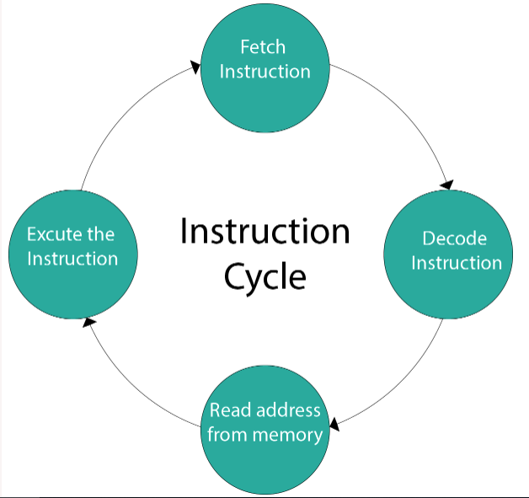
Instruction Cycle
A program residing in the memory unit of a computer consists of a sequence of instructions.
These instructions are executed by the processor
by going through a cycle for each instruction
Also known as the fetch–decode–execute cycle,
or simply the fetch-execute cycle

Slide 4
Clock Cycle
A clock cycle is also known as a clock tick
It is a single increment of the central processing unit (CPU) clock during which the smallest unit of processor activity is carried out.
It helps in determining the speed of the CPU, as it is considered the basic unit of measuring how fast an instruction can be executed by the computer processor
The clock speed of a processor is measured in hertz, which is clock cycles per second.
A CPU which completes three billion clock cycles per second has a clock speed of 3 GHz.

Slide 5
Concurrent Process
Concurrent means something that happens at the same time
Concurrent processing is a computing model in which multiple processors execute instructions simultaneously for better performance
Concurrent processing is sometimes said to be synonymous with parallel processing.
The tasks are broken into sub-types, which are then assigned to different processors to perform simultaneously, sequentially instead, as they would have to be performed by one processor

Slide 6
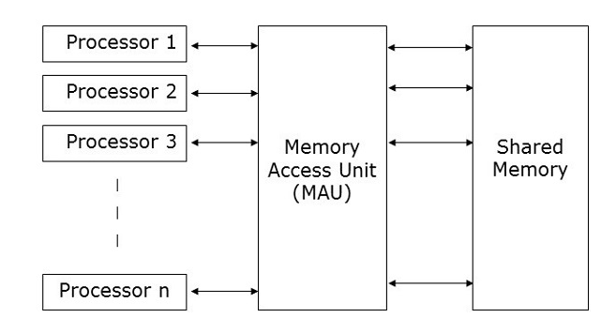
Architecture of Theoretical Parallel Computer
Parallel Random Access Machine (PRAM) is a theoretical model of parallel computer, with
p identical processors
a global memory of unbounded size
memory is uniformly accessible to all processors

Slide 7
Architecture of Theoretical Parallel Computer
In PRAM, Processors share a common clock
They may execute different instructions in each cycle
There are many methods to implement the PRAM model, but the most prominent ones are −
Shared memory model
Message passing model
Data parallel model

Slide 8
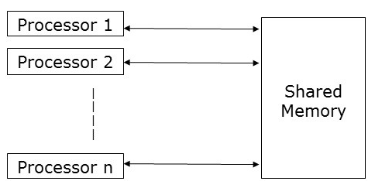
Architecture of Theoretical Parallel Computer
Shared memory model

Slide 9
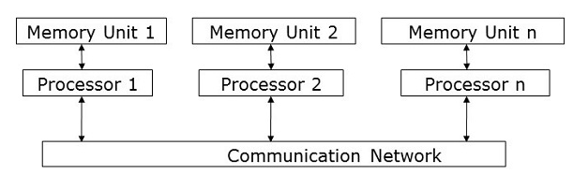
Architecture of Theoretical Parallel Computer
Message passing model

Slide 10
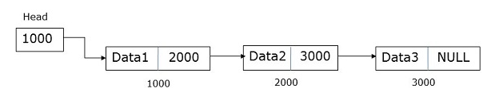
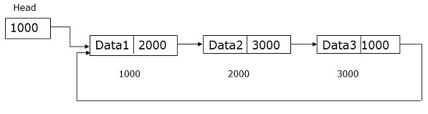
Architecture of Theoretical Parallel Computer
Data parallel model
The major focus of data parallel programming model is on performing operations on a data set simultaneously.
The data set is organized into some structure like an array, hypercube, etc.
Processors perform operations collectively on the same data structure.
Each task is performed on a different partition of the same data structure

Slide 11
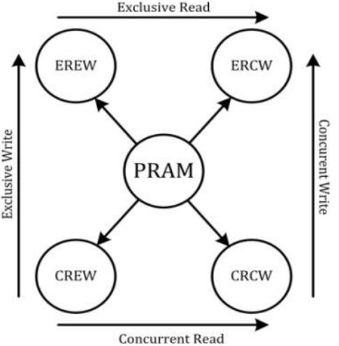
PRAM Subclasses
There are four subclasses of PRAM, based on the memory access protocols

Slide 12
PRAM Subclasses
Exclusive read (ER) − In this method, in each cycle only one processor is allowed to read from any memory location.
Exclusive write (EW) − In this method, at least one processor is allowed to write into a memory location at a time.
Concurrent read (CR) − It allows multiple processors to read the same information from the same memory location in the same cycle.
Concurrent write (CW) − It allows simultaneous write operations to the same memory location. To avoid write conflict some policies are set up.

Slide 13
PRAM Subclasses
EREW: also called Exclusive Read Exclusive Write is a constraint that doesn’t allow two processors to read or write from the same memory location at the same instance. The weakest PRAM model, affording minimum concurrency in memory access
CREW: also called Concurrent Read Exclusive Write is a constraint that allows all the processors to read from the same memory location but are not allowed to write into the same memory location at the same time.
ERCW: also called Exclusive Read Concurrent Write is a constraint that allows all the processors to write to the same memory location but are now allowed to read the same memory location at the same time.
CRCW: also called Concurrent Read Concurrent Write is a constraint that allows all the processors to read from and write to the same memory location parallelly. This is the most powerful PRAM model

Slide 14
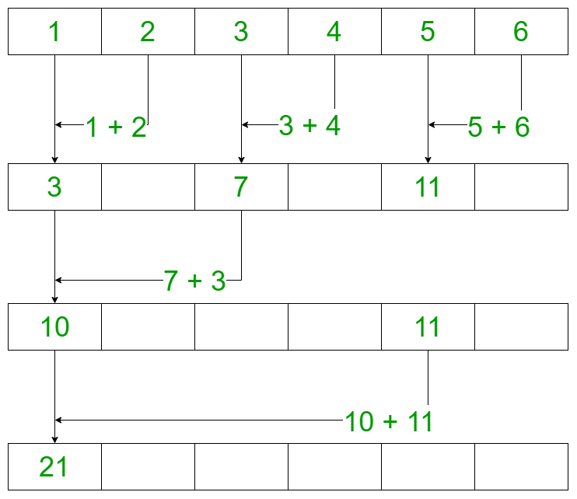
PRAM Example:
Suppose we wish to add an array consisting of N numbers. We generally iterate through the array and use N steps to find the sum of the array. So, if the size of the array is N and for each step, let’s assume the time taken to be 1 second. Therefore, it takes N seconds to complete the iteration.
The same operation can be performed more efficiently using a CRCW model of a PRAM.
Let there be N/2 parallel processors for an array of size N, then the time taken for the execution is 4 which is less than N = 6 seconds in the following illustration.

Slide 15
PRAM Semantics
Concurrent read access to a memory location by all processors is OK.
Concurrent write access to a memory location presents semantic discrepancy and requires arbitration
The most frequently used arbitration protocols are:
Common Arbitration Protocol (Common CRCW): In this protocol, concurrent write operations are allowed if and only if all the writing processors have the same value to write. If there is a conflict where not all processors intend to write the same value, then the write operation fails, and the conflicting processors may need to retry.
Notes:
In simpler terms, when multiple things (like processors or computer programs) want to write information to the same place in a computer's memory at the same time, it can cause confusion or errors because different things might be trying to change that place in different ways. To avoid this confusion, a system needs a way to decide which thing gets to write its information first, and that's what we call "arbitration." It's like deciding who gets to speak in a meeting when multiple people want to talk at once. Arbitration makes sure it happens in an organized and fair way.

Slide 16
PRAM Semantics
Arbitrary Arbitration Protocol: This protocol allows an arbitrary (often the first to access or reach the resource) processor to proceed with the write operation, while the rest of the processors attempting to write to the same location fail. The choice of which processor proceeds is not based on the values they are trying to write but is more of a first-come-first-serve approach.
Priority Arbitration Protocol: In this protocol, processors are assigned priorities a priori, and the processor with the highest priority is allowed to write to the shared resource while the others fail. This approach ensures that the processor with the highest priority always gets access to the shared resource, and it can be useful when certain processors need preferential treatment or have specific roles in the parallel computation.

Slide 17
PRAM Semantics
Sum Arbitration Protocol: In this protocol, all quantities provided by the processors are summed together, and the result of this summation is then written to the shared resource. This is often used when the goal is to aggregate or accumulate values from multiple processors, and the result represents the combined contribution of all processors. This protocol ensures that all contributions are taken into account.
The choice of arbitration protocol depends on the specific needs of the parallel algorithm and the nature of the shared resources in the PRAM model. The goal is to maintain correctness, minimize contention, and optimize the parallel execution of algorithms while avoiding conflicts and ensuring that shared resources are used efficiently.

Slide 18
Processor Granularity
In parallel computing, granularity (or grain size) of a task is a measure of the amount of work (or computation) which is performed by that task
Granularity is usually measured in terms of the number of instructions executed in a particular task.
Alternately, granularity can also be specified in terms of the execution time of a program, combining the computation time and communication time.

Slide 19
Processor Granularity
In parallel computing, Processor granularity sometimes refers to the power of individual processor.
It is also used to denote the degree of parallelism.
Coarse-grained: Few powerful processors
Fine-grained: Many, less powerful processors
Medium-grained: between the above two

Slide 20
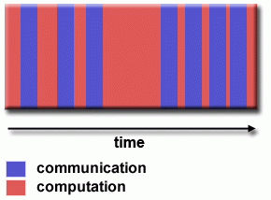
Processor Granularity
Another definition of granularity is with respect to the relative rates of communication to computation
Fine-grain:
Relatively small amounts of computational work are done between communication events.
Low computation to communication ratio.
Facilitates load balancing.
Implies high communication overhead and less opportunity for performance enhancement.
If granularity is too fine, it is possible that the overhead required for communications and synchronization between tasks takes longer than the computation.

Slide 21
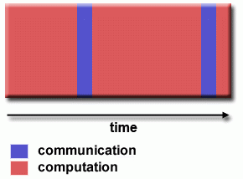
Processor Granularity
Another definition of granularity is with respect to the relative rates of communication to computation
Coarse-grain :
Relatively large amounts of computational work are done between communication/synchronization events
High computation to communication ratio
Implies more opportunity for performance increase
Harder to load balance efficiently

Slide 22
Processor Granularity
Which is Best?
The most efficient granularity is dependent on the algorithm and the hardware environment in which it runs.
In most cases the overhead associated with communications and synchronization is high relative to execution speed, so it is advantageous to have coarse granularity.
Fine-grain parallelism can help reduce overheads due to load imbalance.

Slide 23
Interconnection Networks
Static networks: Processing nodes are connected by point-to-point communication
links (direct networks). Mostly used for message-passing computers
Dynamic networks: Communication links are connected to one another dynamically by the switches to establish paths among processing nodes and memory banks (indirect networks)
Mostly used for shared memory computers

Slide 24
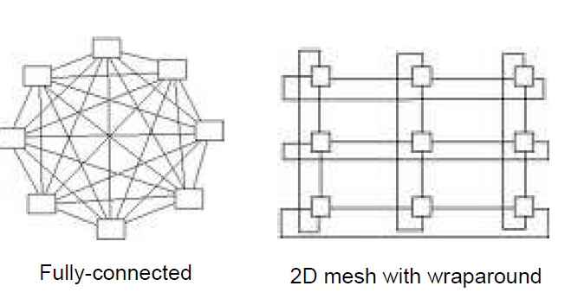
Interconnection Networks
Examples of Static networks

Slide 25
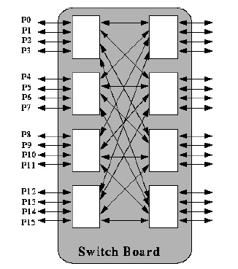
Interconnection Networks
Switch based Connections

Slide 26
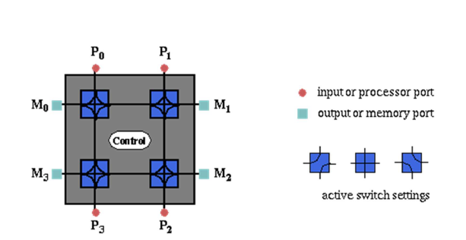
Interconnection Networks
Dynamic Interactions

Slide 27
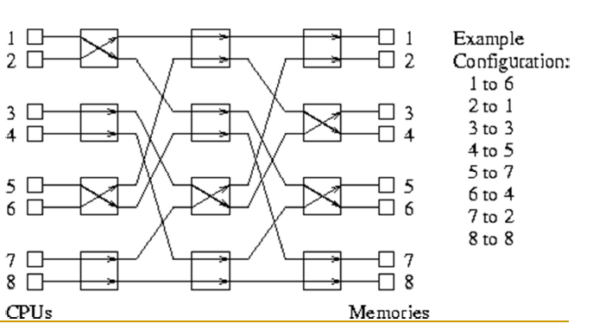
Interconnection Networks
Multistage Dynamic Interactions

Slide 28
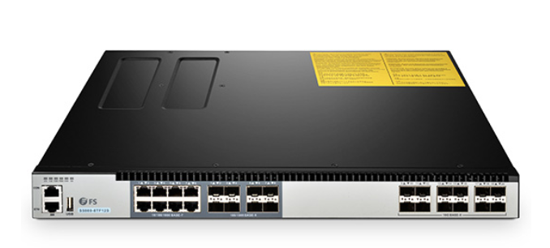
Switch Functionalities & Cost
A switch is a hardware device that filters and forwards network packets from one networking device (switch, router, computer, server, etc.) to another.
A single switch has a set of input ports and a set of output ports

Slide 29
Switch Functionalities & Cost
The switch functionalities include:
a mapping from input to output ports (basic)
additional support for internal buffering (when the requested output port is busy), routing (to alleviate network congestion), and multicasting (same output on multiple ports)
The degree of a switch is the total number of ports
The cost of a switch is influenced by the cost of mapping hardware, the peripheral hardware, and packaging costs

Slide 30
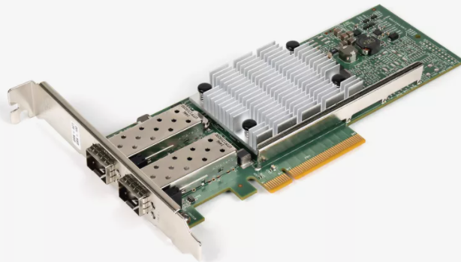
Network Interface
Network interface is to handle the connectivity between the node and the network
A network interface is generally a network interface card (NIC)
Network interface has input and output ports that pipe data into and out of the network
Its functionalities include:
packetizing data
computing routing information
buffering incoming and outgoing data
error checking

Slide 31
Network Interface
Network interface is to handle the connectivity between the node and the network
Network interface has input and output ports that pipe data into and out of the network
Its functionalities include:
packetizing data
computing routing information
buffering incoming and outgoing data
error checking
For dynamic interconnection networks: Its cost is proportional to the number of switches used in the network
For static Interconnection networks: Its cost is proportional to the number of links

Slide 32
Network Topologies
Multiple processors must be working together to solve a common task
They must communicate during the course of solving the task problems
The communication is provided by the interconnection networks
How to connect multiple processors in a parallel system -This is a trade-off between cost and scalability with performance

Slide 33
Bus Based Network
A bus-based network consists of a shared medium that connects all nodes
The cost of a bus-based network scales linearly with respect to the number of processors p
The distance between any two nodes in the network is constant O(1)
Ideal for broadcasting information
Disadvantage: bounded bandwidth & blocking Performance is not scalable with respect to the number of processors p

Slide 34
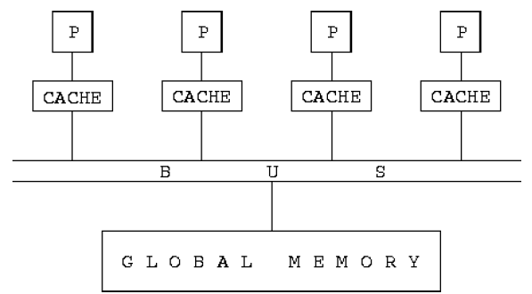
Bus Based Network

Slide 35
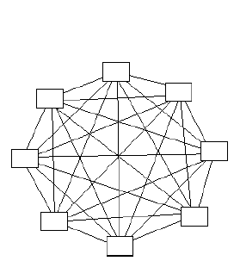
Completely Connect Network
Each node has a direct communication link to every other node in the network (non-blocking)
How many communication links are needed?
Scalable in terms of performance, not scalable in terms of cost

Slide 36
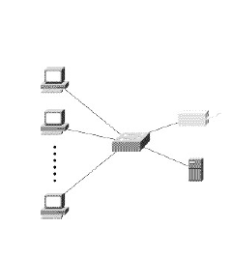
Star Connect Network
One processor acts as the central processor
Every other processor has a communication link with this processor
Congestion may happen at the central processor
This is a blocking network
Scalable in terms of cost, not scalable in terms of performance

Slide 37
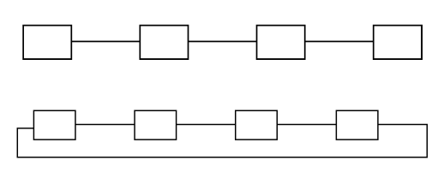
Linear Array and Ring Networks
Scalable in terms of costs, not scalable in terms of performance

Slide 38
Crossbar Network
A crossbar network uses a grid of switches or switching nodes to connect p processors to b memory banks
It is a non-blocking network
The total number of switching nodes is Θ(pb)
In many cases, b is at least on the order of p, the complexity of the crossbar network is Ω(p*p)
Disadvantage: Switch complexity is difficult to realize at high data rates
Scalable in terms of performance, but not scalable in terms of cost

Slide 39
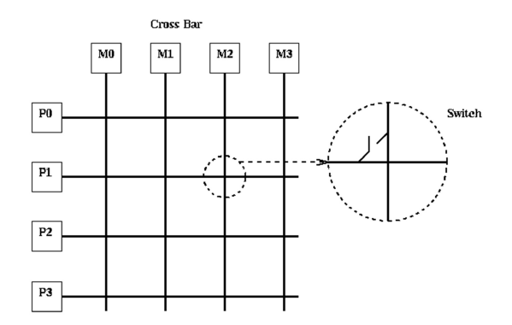
Crossbar Network

Slide 40
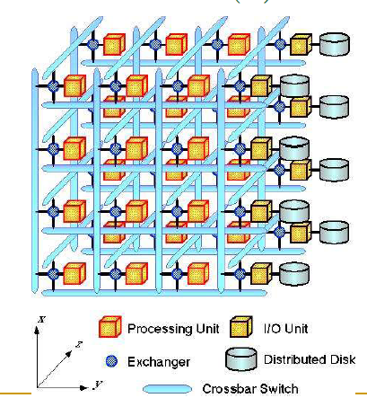
Crossbar Network

Slide 41
Multistage Network
To balance the scalability between performance and costs
Allowing multiple stages between processors and memory banks
Switches are installed at each stage
It is more scalable than bus-based networks in terms of performance
It is more scalable than the crossbar networks in terms of costs
A special multistage interconnection network is the omega network

Slide 42
Multistage Network
Multistage Interactions

Slide 43
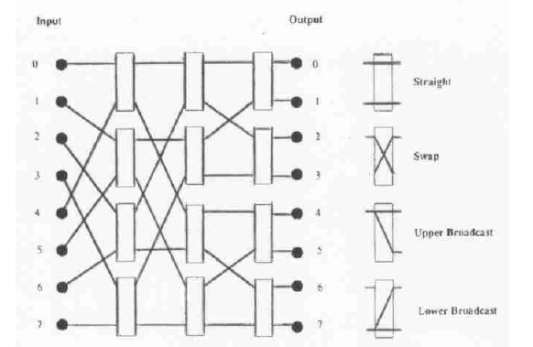
Multistage Network
Multistage Interactions

Slide 44
Metrics for Dynamic Interconnection Networks
Evaluating dynamic interconnection networks in terms of their usefulness for parallel computing and technical feasibility, can be carried out by applying similar metrics as for static interconnection networks.
Before discussing some of the metrics, we need to expand slightly the concept of network node assuming that it can be not only a processor, memory module, I/O device etc., but also a switch.

Slide 45
Metrics for Dynamic Interconnection Networks
The diameter of a dynamic network specifies the maximum number of links along which a message must pass from a source to target node.
The diameter approximates the latency in message transfer through the network.
Therefore, while evaluating the diameter of a dynamic network we should pay attention on the longest path between a pair of processors, and not between a pair of nodes (for example, between a pair of switches).
The maximum degree of a vertex node, which is the number of links adjacent to it, impacts the complexity of the routing procedure running in a processor or the complexity of a switch.

Slide 46
Metrics for Dynamic Interconnection Networks
The bisection width of a network is the minimum number of links that must be removed from a network to divide it into two equal parts.
The bisection width multiplied by the bandwidth of a single link determines the number of bits that can be transferred per unit time between the two halves of a network.
The general definition of this metric is slightly modified for dynamic networks, because only processors are the source and target points of data transmissions.
Therefore, the halves of a network—created by removing links that define the bisection width—should be understood as subnetworks containing half the number of network processors, and not half the number of its nodes. T

Slide 47
Metrics for Dynamic Interconnection Networks
bisection bandwidth Often used to describe network performance
- Cut network in half and sum bandwidth of links severed
- (Min # channels spanning two halves) * (BW of each channel)
- Meaningful only for recursive topologies
- Can be misleading, because does not account for switch and routing efficient

Slide 48
Metrics for Dynamic Interconnection Networks
Cost: The number of links or switches (whichever is asymptotically higher) is a meaningful measure of the cost. However, a number of other factors, such as the ability to layout the network, the length of wires, etc., also factor in to the cost.
Channel Bandwidth: Think of it like the width of a water pipe. In a static network, it's how much data can flow through the pipe at once. In a dynamic network, it's how flexible the pipe is in handling different amounts of water.

Slide 49
Metrics for Dynamic Interconnection Networks
Channel Rate: This is how fast the data flows through the pipe. In a static network, it's like the speed of water in a river. In a dynamic network, this speed can change depending on what's needed.
Channel Width: In a static network, this is like the physical size of the pipe. A wider pipe can carry more data. In a dynamic network, it's about how many things can flow through the pipe at the same time, like many small pipes side by side.
So, in simple terms, channel bandwidth is about how much data the pipe can carry, channel rate is about how fast the data moves in the pipe, and channel width is like how many things can go through the pipe at once. The difference between static and dynamic networks is that dynamic ones can adjust these factors as needed.

